Slide 1

Team 2 - Spartans

Slide 2

Vasanth Kumaar S B Santhosh T K Praveen G
23z436 22z433 22z434

Slide 3
Problem Statement Chosen - 2 GCS - Google Cloud Services
We are asked to create a CLI ( Command Line Interface ) for Google Cloud Services (e.g., Google compute engine is a cloud service to perform computations ). 🤔
Why don’t we build a CLI that has some commands to interact with the GCS ?
“DON’T REINVENT THE WHEEL” 🙅
Google Cloud SDK : It includes the Google Cloud Command Line Interface (gcloud CLI) and Cloud Client Libraries.
Pain Points:
Hard-to-Remember Commands & Syntax Complexity
Too Many Subcommands (e.g., compute, container)

Slide 4
What we can bring to the table ?
Curious right !!
We have built a CLI tool, that reads Natural Language and execute the corresponding gcloud command.
Executes the generated gcloud commands automatically
Ensures low latency and high correctness
Works locally without relying on external APIs

Slide 5
Attempt 1 - Rule-Based NLP (Regex + SpaCy)
Approach:
Used regex and rule-based parsing to extract keywords (e.g., "list TPU" → gcloud compute tpus list).
Mapped input keywords to gcloud command templates.
Limitations:
Limited flexibility – Cannot understand new sentence structures
High maintenance – Adding new commands requires manual rule updates
Fails with variations – Example: ( "Show all TPU nodes" → Works, "Can you display all my TPUs?" → Fails)
Why We Switched?
Hard to scale – Writing rules for every possible phrasing is not practical.
Not adaptable – Cannot handle complex or unseen requests.

Slide 6

Attempt 2 - Cloud-Based LLM (GPT-4 API, Google PaLM API)
Approach:
Used OpenAI GPT-4 and Google PaLM APIs to convert NL to gcloud CLI.
Example prompt: Convert "List all TPU instances" into a valid gcloud command.
Limitations:
Expensive – Each API request costs money per call.
Latency Issues – Network-based APIs take 1-3 seconds per request.

Slide 7
Attempt 3 - Local LLM (Ollama + LLaMA 3)
Approach:
Used Ollama to run LLaMA 3 locally on the machine.
Generates gcloud commands directly from natural language.
Example conversion:
Input: "List all TPU nodes in zone us-central1"
Output: gcloud compute tpus list --zone=us-central1

Slide 8
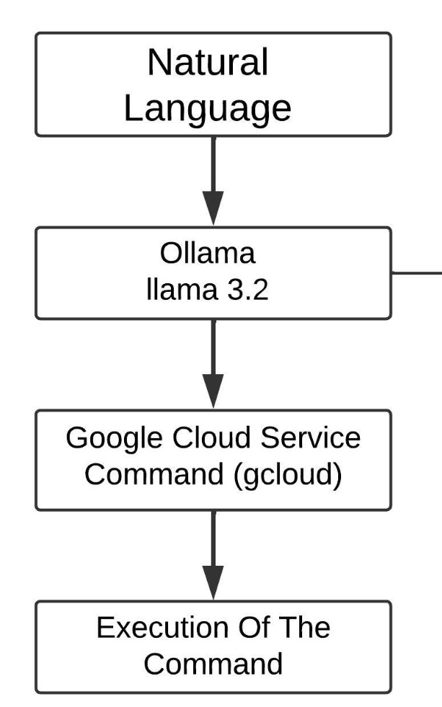
High Level Architecture

Slide 9
Latency Equation
Where:
Tconversion​ = Time taken to convert natural language → gcloud command (Ollama processing time).
Texecution​ = Time taken to run the gcloud command and receive a response.

Slide 10

2. Cost Equation
Where:
Nrequests​ = Number of API calls made.
Cper_request​ = Cost per API call (e.g., GPT-4 API costs $0.002 - $0.02 per request).
For Ollama & Rule-Based NLP, cost is zero since they run locally:
Ctotal=0

Slide 11

3. CPU Usage
Where:
Pused​ = CPU power consumed by the approach (LLM inference, regex, or API calls).
Pavailable​ = Total available CPU power.
Approximate CPU Usage by Approach:
Ucpu,Rule-Based≈2%
Ucpu,Cloud-LLM​≈50%
Ucpu,Ollama-LLM≈20%

Slide 12

4. Scalability Score
Where:
Mmanual​ = Number of manual rule updates needed for new commands.
Ncommands​ = Total number of commands supported.
Scalability Estimates:
SRule-Based≈0.3(Low, requires manual rule updates)
SCloud-LLM≈0.9(High, learns from cloud data)
SOllama-LLM​≈0.85(High, can be fine-tuned locally)

Slide 13

5. Accuracy Formula
Where:
Ncorrect​ = Number of correctly generated gcloud commands.
Ntotal​ = Total test cases.
Estimated Accuracy by Approach:
ARule-Based≈50%(Fails on varied inputs)
ACloud-LLM≈95%(Very high, but costly)
AOllama-LLM≈90%(Nearly as good as Cloud, but offline)

Slide 14
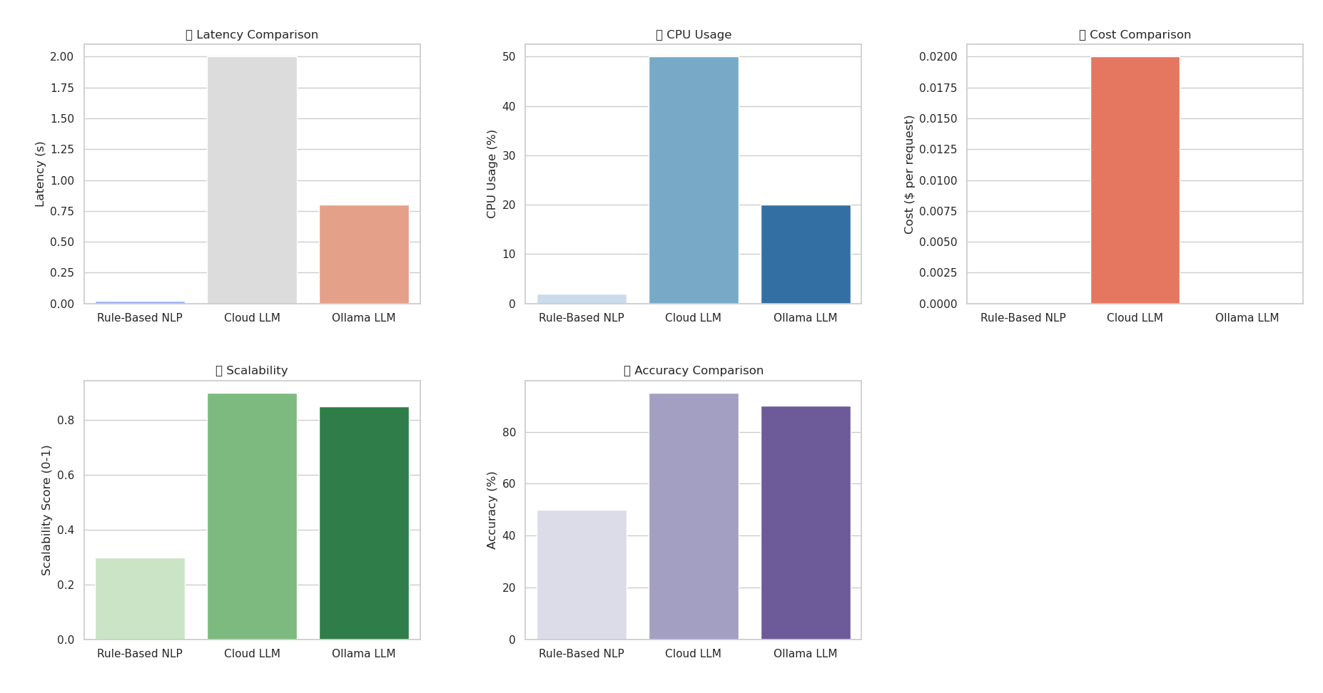

Slide 15
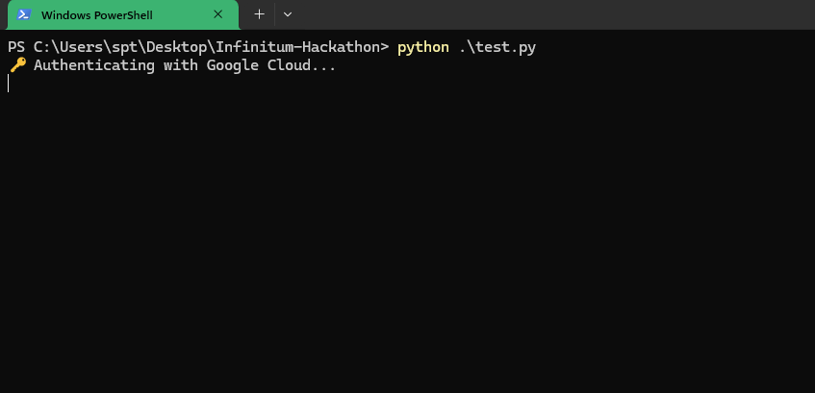

Slide 16
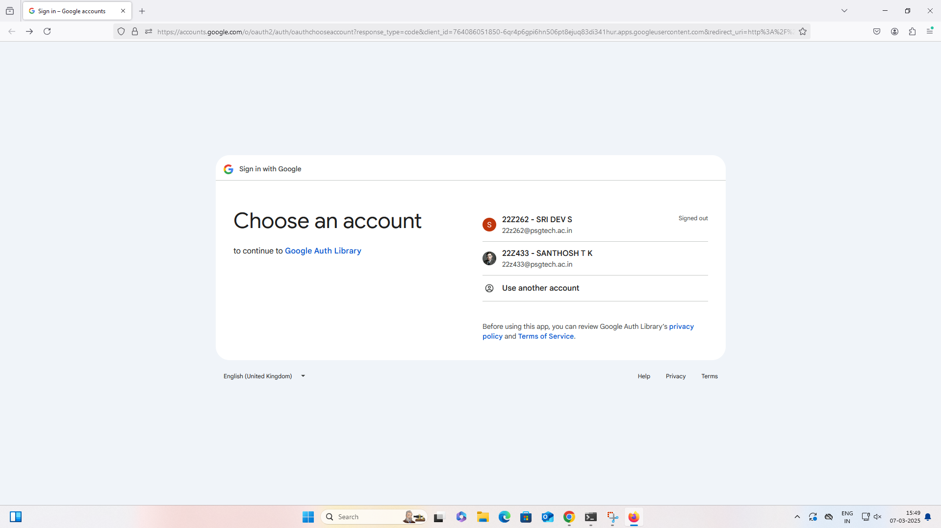

Slide 17
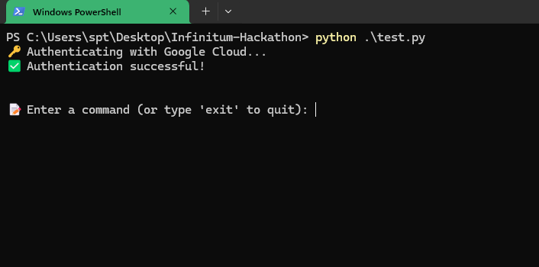

Slide 18
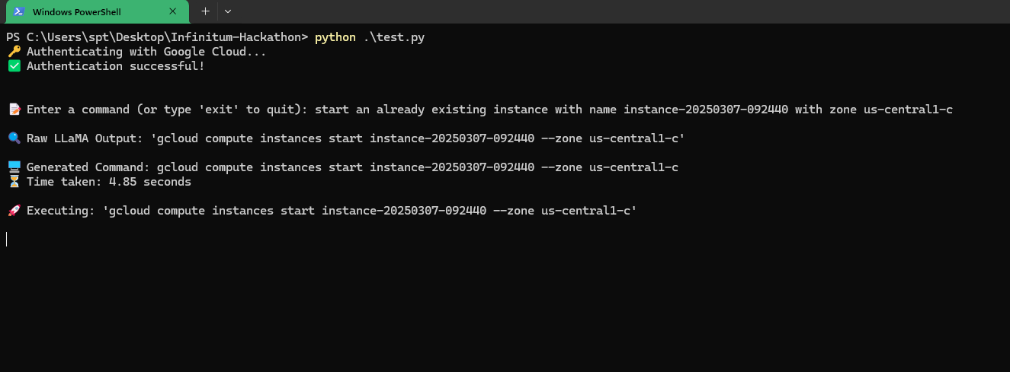

Slide 19
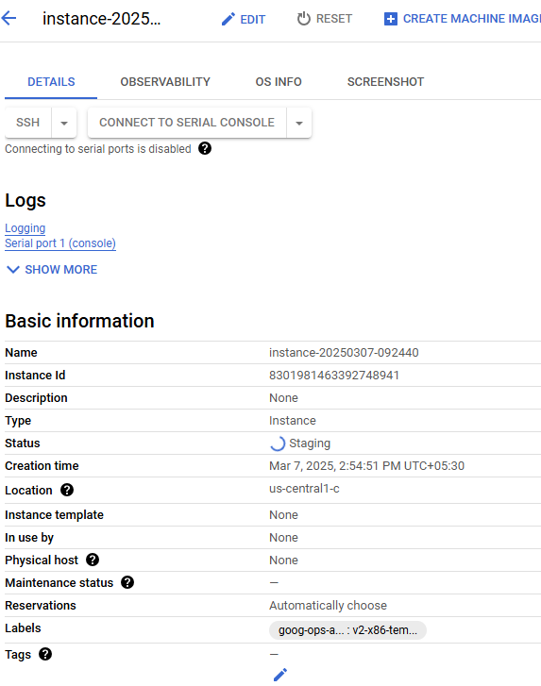

Slide 20
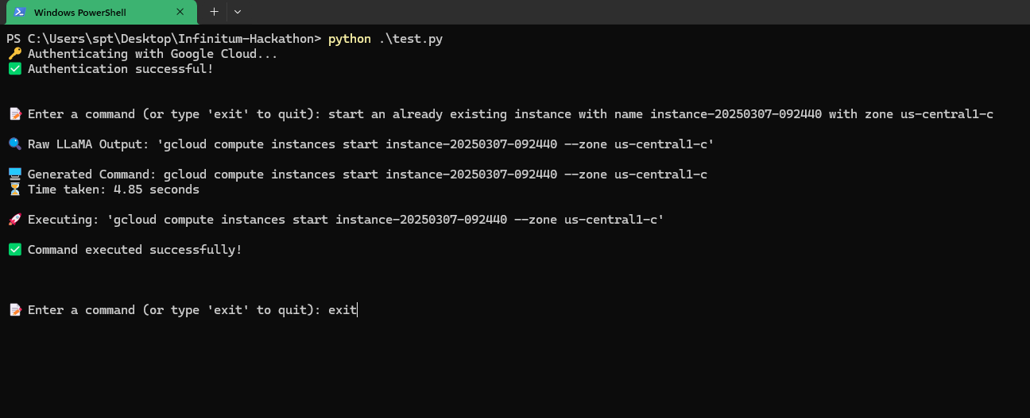

Slide 21
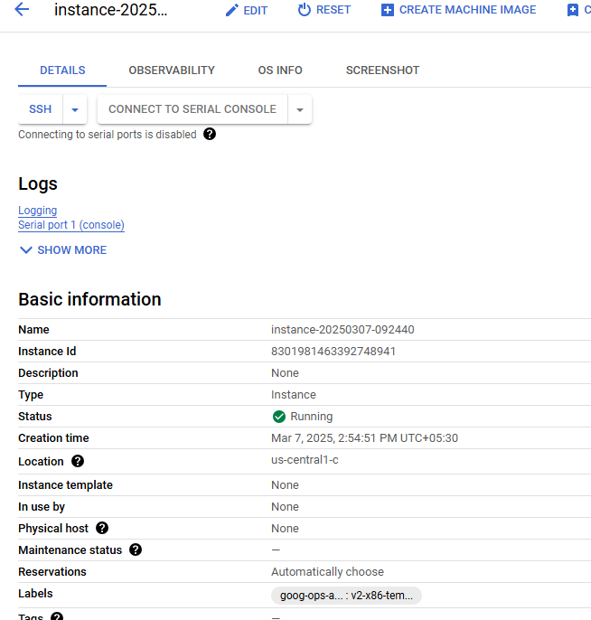

Slide 22
